Slide 1


Slide 2



SOCKET PROGRAMMING

Slide 3

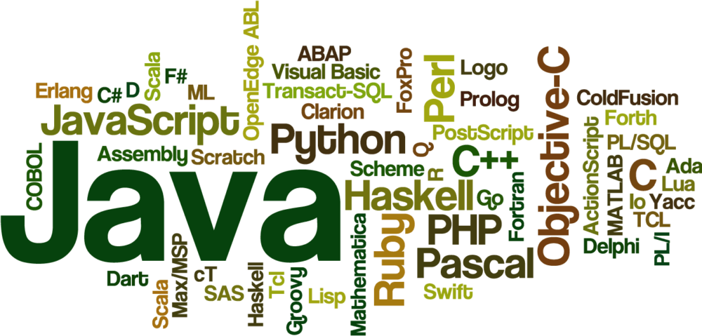


Slide 4
Java Socket Programming
Java Socket programming is used for communication between the applications running on different JRE.
Java Socket programming can be connection-oriented or connection-less.
Socket and ServerSocket classes are used for connection-oriented socket programming and DatagramSocket and DatagramPacket classes are used for connection-less socket programming

Slide 5
SOCKET CLASS
A socket is simply an endpoint for communications between the machines. The Socket class can be used to create a socket.
method | Description
public InputStream getInputStream() | returns the InputStream attached with this socket.
public OutputStream getOutputStream() | returns the OutputStream attached with this socket.
public synchronized void close() | closes this socket

Slide 6
Establish a Socket Connection
To connect to other machine we need a socket connection.
A socket connection means the two machines have information about each other’s network location (IP Address) and TCP port.
The java.net.Socket class represents a Socket. To open a socket: Socket socket = new Socket(“127.0.0.1”, 5000)
Notes:
First argument – IP address of Server. ( 127.0.0.1 is the IP address of localhost, where code will run on single stand-alone machine).
Second argument – TCP Port. (Just a number representing which application to run on a server. For example, HTTP runs on port 80. Port number can be from 0 to 65535)

Slide 7
CONTINUED..
Communication
To communicate over a socket connection, streams are used to both input and output the data.
Closing the connection
The socket connection is closed explicitly once the message to server is sent.
In the program, Client keeps reading input from user and sends to the server until “Over” is typed.

Slide 8
ServerSocket class
The ServerSocket class can be used to create a server socket.
This object is used to establish communication with the clients.
Important methods
Method | Description
public Socket accept() | returns the socket and establish a connection between server and client.
public synchronized void close() | closes the server socket

Slide 9
Example of Java Socket Programming
Creating Server:
To create the server application, we need to create the instance of ServerSocket class.
Here, we are using 6666 port number for the communication between the client and server.
The accept() method waits for the client. If clients connects with the given port number, it returns an instance of Socket.

Slide 10
EXAMPLE:
ServerSocket ss=new ServerSocket(6666); Socket s=ss.accept();//establishes connection and waits for the client
Creating Client:
To create the client application, we need to create the instance of Socket class.
Here, we need to pass the IP address or hostname of the Server and a port number.
Here, we are using "localhost" because our server is running on same system
Notes:
Socket s=new Socket("localhost",6666);

Slide 11
MyClient.java
import java.io.*; import java.net.*; public class MyClient { public static void main(String[] args) { try{ Socket s=new Socket("localhost",6666); DataOutputStream dout=new DataOutputStream(s.getOutputStream()); dout.writeUTF("Hello Server"); dout.flush(); dout.close(); s.close(); }catch(Exception e){System.out.println(e);} } }

Slide 12
MyServer.java
import java.io.*; import java.net.*; public class MyServer { public static void main(String[] args){ try{ ServerSocket ss=new ServerSocket(6666); Socket s=ss.accept();//establishes connection DataInputStream dis=new DataInputStream(s.getInputStream()); String str=(String)dis.readUTF(); System.out.println("message= "+str); ss.close(); }catch(Exception e){System.out.println(e);} } }

Slide 13
IMPORTANT POINTS:
Server application makes a ServerSocket on a specific port which is 5000.
This starts our Server listening for client requests coming in for port 5000.
Then Server makes a new Socket to communicate with the client.
The accept() method blocks(just sits there) until a client connects to the server.
Then we take input from the socket using getInputStream() method. Our Server keeps receiving messages until the Client sends “Over”.
After we’re done we close the connection by closing the socket and the input stream.
To run the Client and Server application on your machine, compile both of them. Then first run the server application and then run the Client application.

Slide 14

THANK YOU

